Slide 1
Chapter 10: Human–Computer Interaction Layer Design

Slide 2
Introduction
Interface Design defines how the system will interact with external entities (e.g., customers, users, other systems)
System Interfaces are machine-machine and are dealt with as part of systems integration
User Interfaces are human-computer and are the focus of this chapter
Principles for UI design
The UI design process

Slide 3
Principles of User Interface Design
Layout of the screen, form or report
Content Awareness—how well the user understands the information contained
Aesthetics—how well does it appeal to the user
User Experience—is it easy to use? – Impossible to Quantify
Consistency (Continuity/Coherence)—refers to the similarity of presentation in different areas of the application
Minimal User Effort—can tasks be accomplished quickly? – Difficult to Quantify

Slide 4
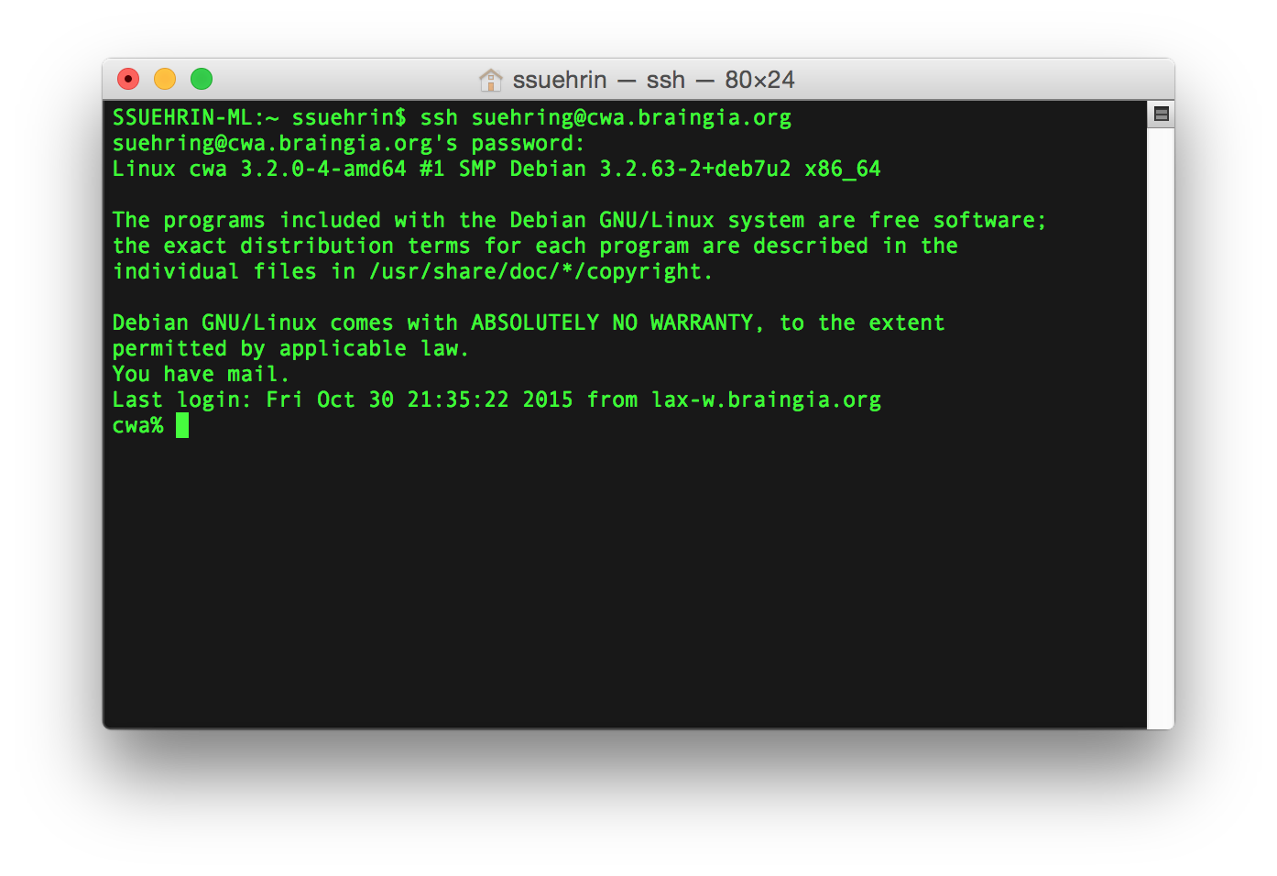
"User-Friendly"
The term "User-Friendly" is in the eye of the "User" and is not an objective measure.

Slide 5
Layout
The arrangement of items on the screen
Like items are grouped into areas
Areas can be further subdivided
Each area is self-contained
Areas should have a natural intuitive flow – What is intuitive?
Users from western nations tend to read from left to right and top to bottom
Users from other regions may have different flows

Slide 6
Content Awareness
Applies to the interface in general, to each screen, to each area on a screen and to sub-areas as well
Include titles on all interfaces
Menus should show where the user is and how the user got there
All areas should be well defined, logically grouped together and easily discernible visually

Slide 7
User Experience
Ease of learning
Significant issue for inexperienced users
Relevant to systems with a large user population
Ease of use
Significant issue for expert users
Most important in specialized systems

Slide 8
Consistency
Extremely important concept in making the system simple
It allows the users to predict what is going to happen
All parts of the system work in the same way
Users learn how one portion works and immediately apply it to others
Key areas of consistency are
Navigation controls
Terminology—use the same descriptors on forms & reports
Consistency across versions
Large-scale changes between versions can alienate the userbase.
Be careful when viable alternatives exist.

Slide 9

Minimal User Effort
Interfaces should be designed to minimize the effort needed to accomplish tasks
A common rule is the three-clicks rule
Users should be able to go from main menu of a system to the information they want in no more than three mouse clicks
1
2
3

Slide 10
User Interface Design Process
Use case driven, incremental and iterative process
Examine use case and sequence diagrams
Develop use scenarios that describe commonly employed patterns of actions. It may uncover additional requirements
Once a basic set of use scenarios have been developed, the actual user interfaces are designed
Designed low-fidelity interfaces are evaluated to determine if they are satisfactory and how they can be improved
Interface design process is repeated in a cyclical process until no new improvements are identified.

Slide 11
Interface Design Prototyping
Mock-ups or simulations of computer screens, forms, and reports
Four common approaches (listed in increasing detail)
Storyboard: hand drawn pictures of what the screens will look like
Windows layout diagram (wireframe): a computer generated storyboard that more closely resembles the actual interface
HTML prototype: web pages linked with hypertext – Low-fi
Language prototype: more sophisticated than HTML
Built in the programming language with no real functionality
User does not have to guess about the final appearance of the screen

Slide 12
Interface Evaluation
Goal is to understand how to improve the interface design before the system is complete.
Ideally, interface evaluation is done while the system is being designed—before it is built
Help identify and correct problems early
Designs will likely go through several changes after the users see it for the first time

Slide 13
Approaches to UI Evaluation
Heuristic—compare the design to known principles or rules of thumb
Walkthrough evaluation—design team presents prototype to the users & explains how it works
Interactive—the users work with the prototype with a project team member
Formal Usability Testing—performed in labs with users on a language prototype

